Slide 1
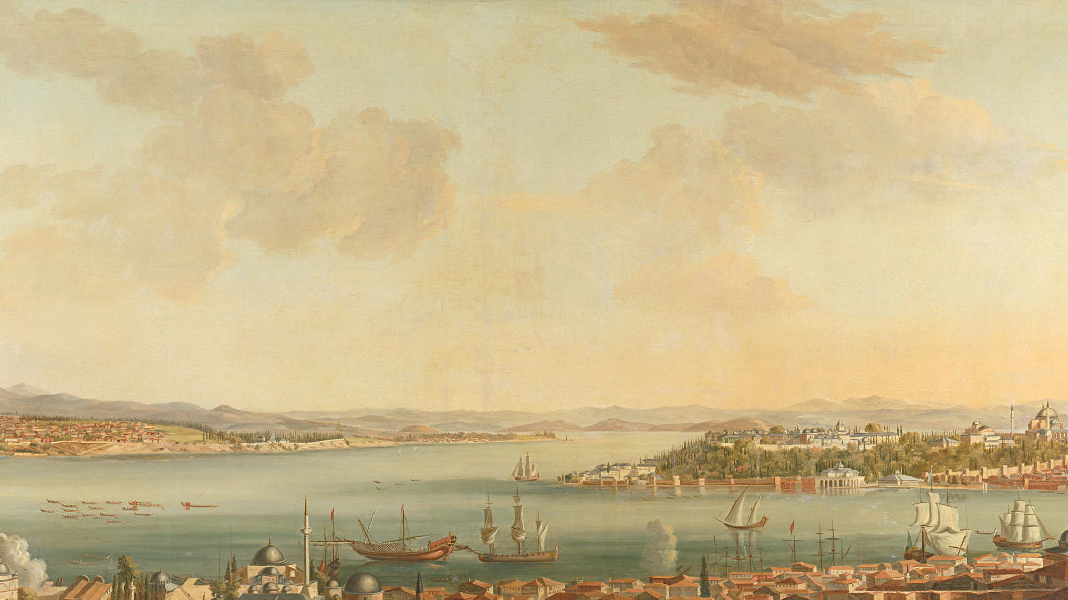
D)fi)TAL )KAfiE PROCESS)Nfi SWE1010
Multi-Year Sentinel-2 Driven Land Use Classification and fieo-Analytical Storage Framework Using UNet for the Perungudi Region
DONE BY:
JANANI P 22MIA1087
MEDHAA 22MIA1171

Slide 2
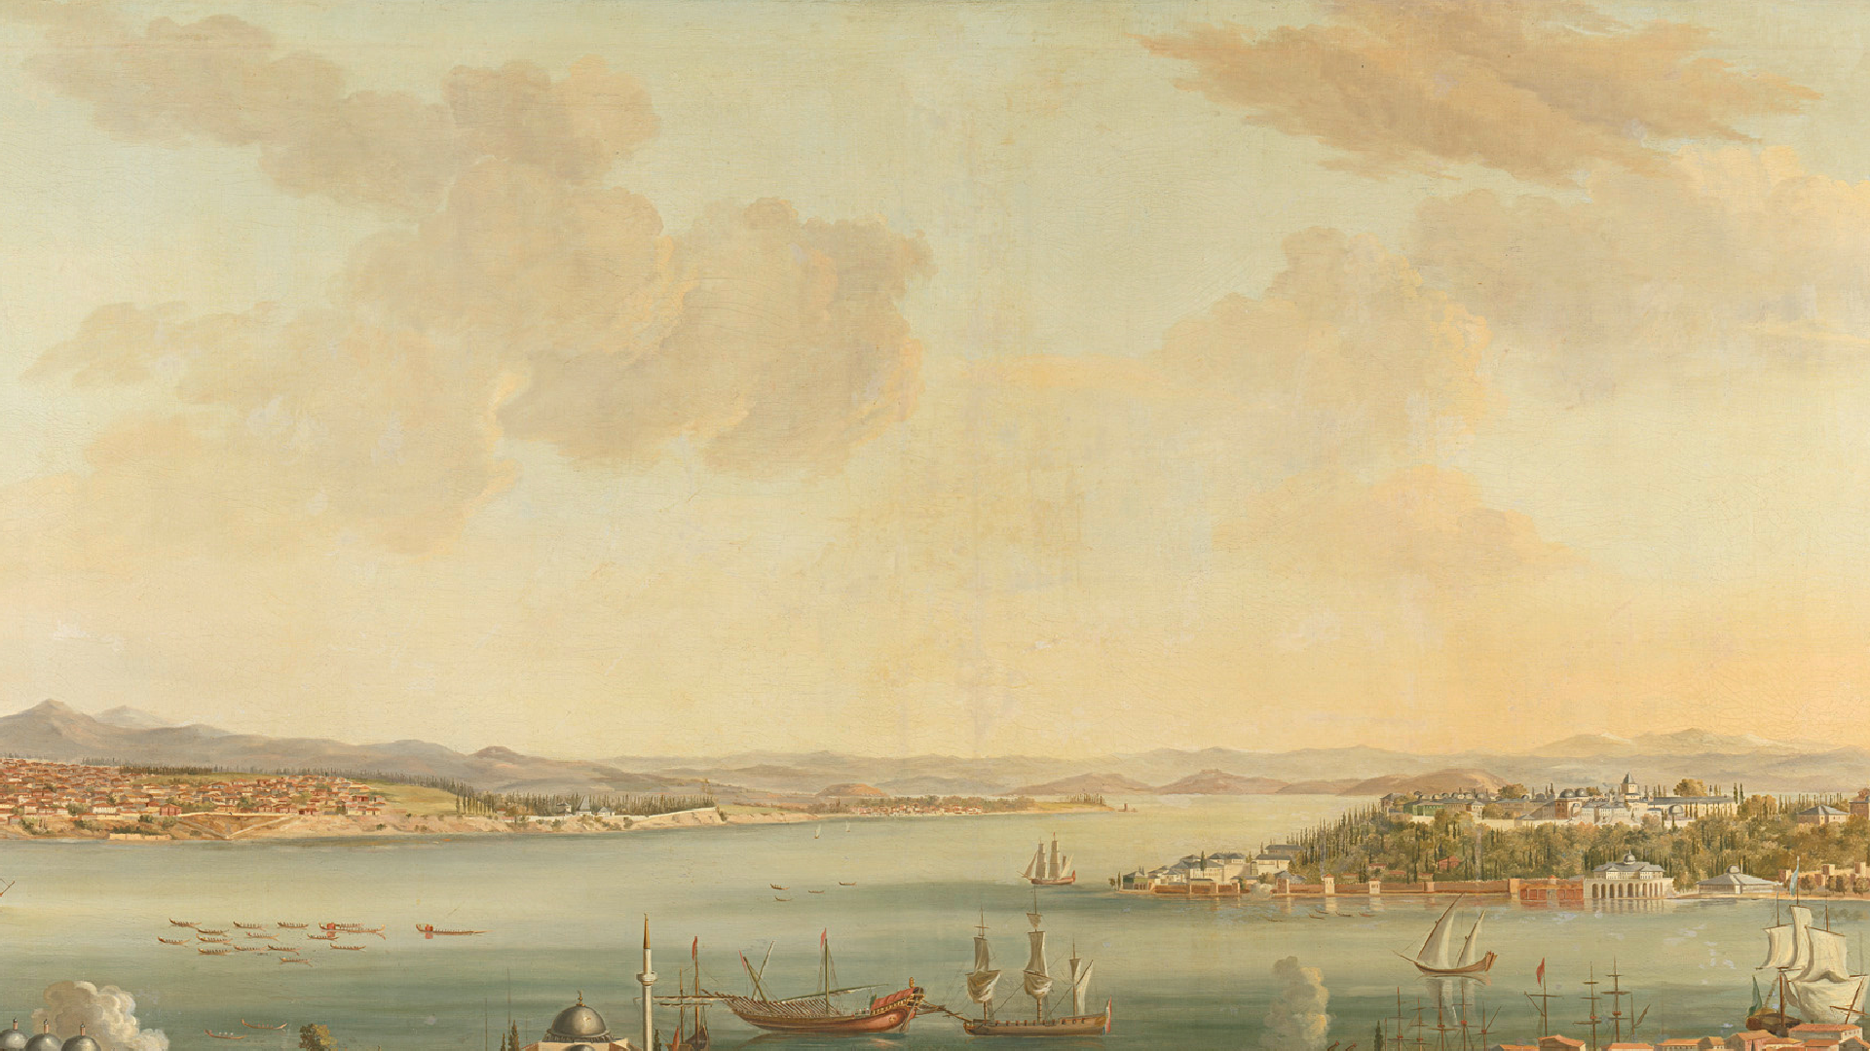

Problem Statement

Slide 3

Base Paper Summary
The base paper introduces IRUNet, an ensemble deep learning model that integrates InceptionResNetV2 and UNet architectures for accurate land use classification using multi-year Sentinel-2 imagery. Tested on the Katpadi region (2017–2024) with eight land use classes, IRUNet utilizes multi-scale feature fusion and Test- Time Augmentation for robust performance. It outperformed other models (UNet, ResUNet, Attention-UNet), achieving 98.21% accuracy and strong scores on all key metrics. The method proves highly effective for urban, agricultural, and environmental monitoring, though further generalization to broader areas and explicit time-series modeling are suggested for future research

Slide 4
Methodology
PREPROCESSINfi STEPS
Images underwent atmospheric correction, cloud/cirrus masking, band stacking, and normalization across spectral channels. Key indices (NDVI, NDWI, NDBI) were calculated to distinguish between urban, vegetative, and water areas.
Manually annotated polygons, verified by high- resolution imagery and cadastral maps, created ground truth masks for major land cover classes: Urban, Vegetation, Waterbody, and Wasteland.
STUDY AREA AND DATA ACQUISITION
The Perungudi region in Chennai, India, was selected due to rapid urban expansion. Sentinel-2 Level-2A surface reflectance images (13 spectral bands, 10–60 m resolution) from 2023–2024 were downloaded using fioogle Earth Engine (fiEE).

Slide 5
Methodology
Data Preparation
Four spatially diverse sample tiles (256×256 pixels) were annotated; images were tiled (128×128 px) and split into training (80%), validation
(10%), and test (10%) sets.
Data augmentation (flips) was applied to improve model generalization
Model Development
IRUNet, a hybrid model combining InceptionResNetV2 encoder and U-Net decoder, was trained (150 epochs, batch size 16) using Nadam optimizer and a mix of Dice loss and binary cross-entropy. Test-Time Augmentation improved segmentation robustness. Results were benchmarked against UNet, ResUNet, Attention-UNet, and Random Forest models.
Evaluation and Storage
Model performance was evaluated using accuracy, precision, recall, F1-score, Dice Similarity, Intersection-over-Union, and
Cohen’s Kappa. Classified maps and spatial data were stored in MongoDB, enabling geo-tagged queries and interactive dashboards for visualization and policy support.

Slide 6
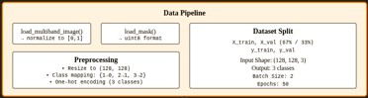
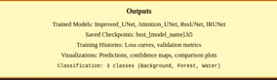
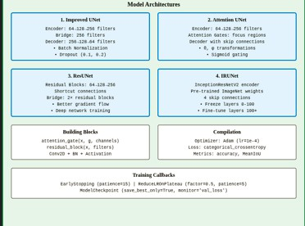
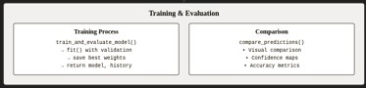
/lowcSaxz

Slide 7
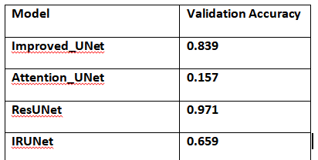
Results ( Images, Metrics, Graphs )
Visual Results
The image shows the segmentation and classification outputs produced by the IRUNet and baseline models on Sentinel-2 data for the Perungudi region.
Visualizations include:
Input satellite image
firound truth annotation mask Predicted segmentation masks Confidence map and error map Class-wise prediction overlays Spatial error analysis
Validation Accuracies

Slide 8
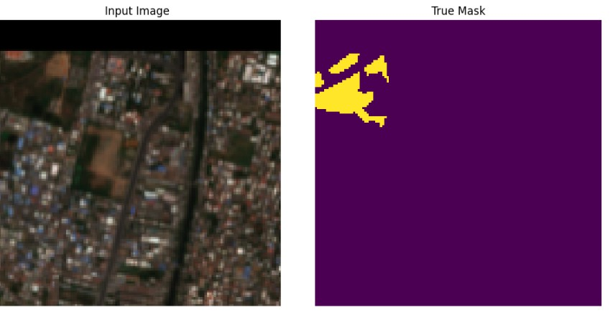
/soual 29oulzo

Slide 9
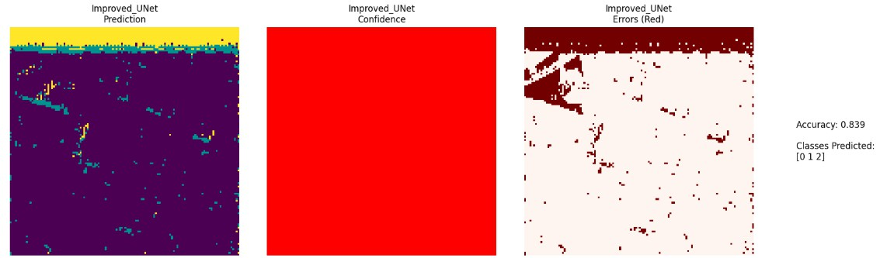
Improved UNet

Slide 10
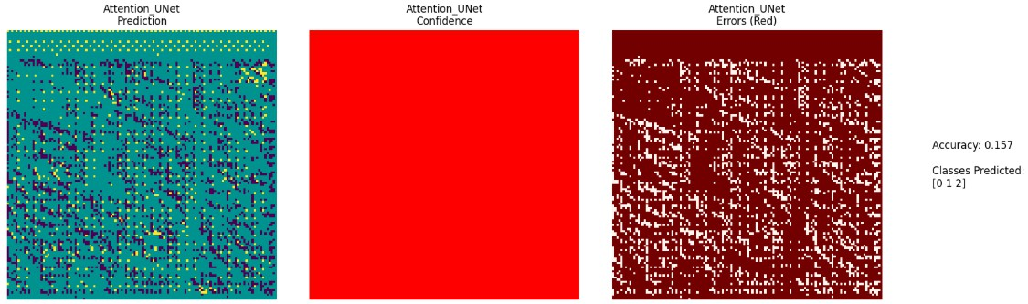
Attention UNet

Slide 11
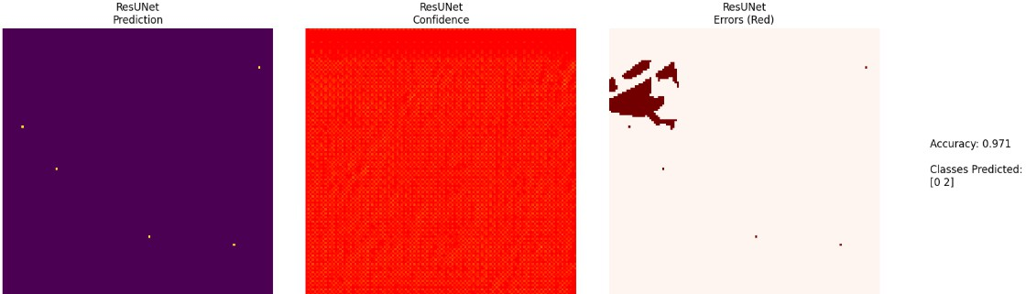
ResUNet

Slide 12
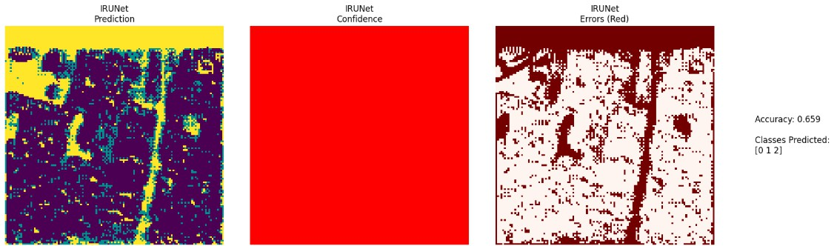
IRUNet

Slide 13
